Slide 1

TOUR AND TRAVEL CUSTOMER CHURN PREDICTIONS
Analyzing Key Factors Influencing Customer Retention

Slide 2
INTRODUCTION
This presentation delves into the analysis of factors affecting customer churn in the tour and travel industry, with a focus on frequent flyers, service preferences, and demographic insights.
The analysis leverages data on customer demographics, service usage, and social media engagement to predict churn and retention trends.

Slide 3
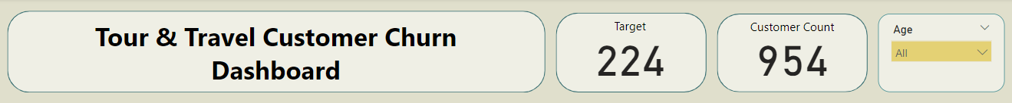
KPI & FILTER TARGET CUSTOMERS, TOTAL CUSTOMER COUNT, AND AGE FILTERED ANALYSIS
A comparative analysis of target customers versus total customer count helps identify the proportion of at-risk customers and the effectiveness of our retention strategies. Additionally, applying an age filter provides a deeper dive into the data, offering granular insights into age-specific trends and behaviors. This comprehensive view enhances our understanding of customer dynamics and supports targeted strategy development.

Slide 4
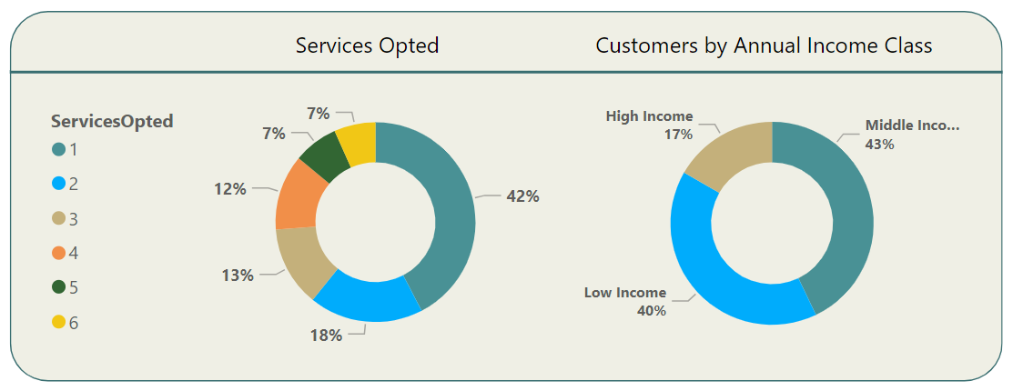
Insights SERVICE OPTED AND CUSTOMER BY ANNUAL INCOME CLASS
This visualization showcases how service preferences vary across different annual income classes, providing insights into spending behavior and service demand.

Slide 5
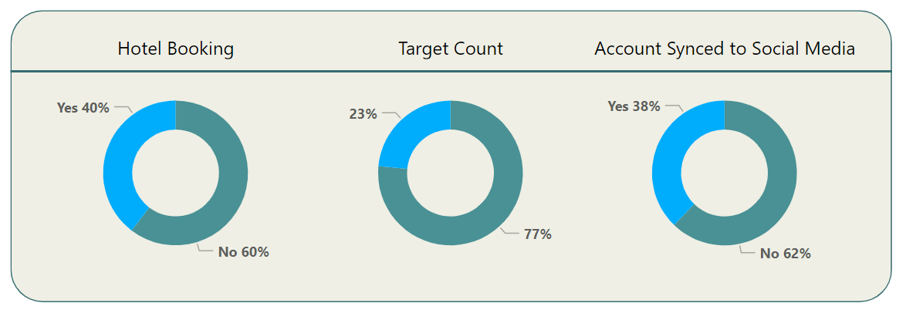
Insights Booking & Customer Retention
Hotel Booking Insights and Customer Retention, Analyzing hotel booking preferences reveals patterns in customer choices, which can guide targeted marketing strategies for different segments. This includes a breakdown of the target count, distinguishing between customers likely to churn and those expected to stay, aiding in focused retention efforts. Additionally, understanding the impact of social media engagement shows the correlation between social media account sync and customer retention.

Slide 6
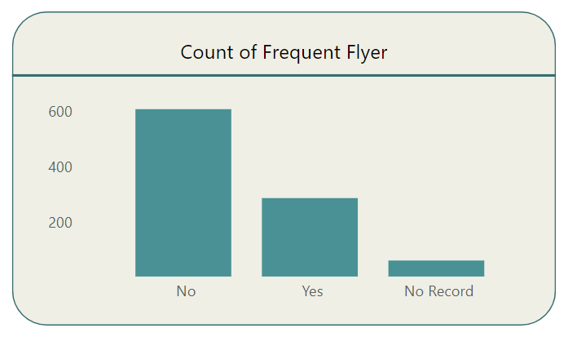
Insights FREQUENT FLYER COUNT BY AGE
This chart illustrates the distribution of frequent flyers across different age groups, highlighting the age demographics of our most loyal customers.

Slide 7
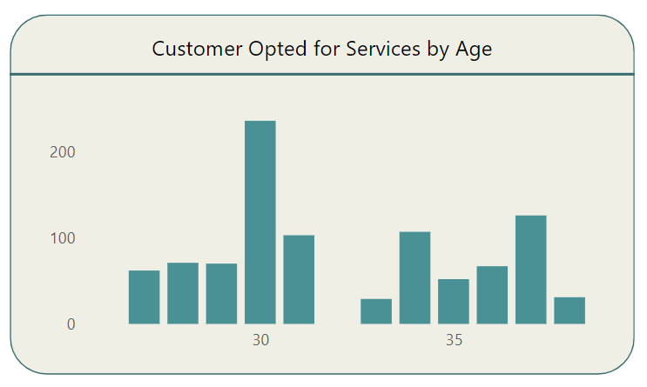
Insights SERVICE OPTED BY AGE
Here, we see the correlation between age groups and the types of services opted for, helping us understand which services are popular among different age brackets.

Slide 8
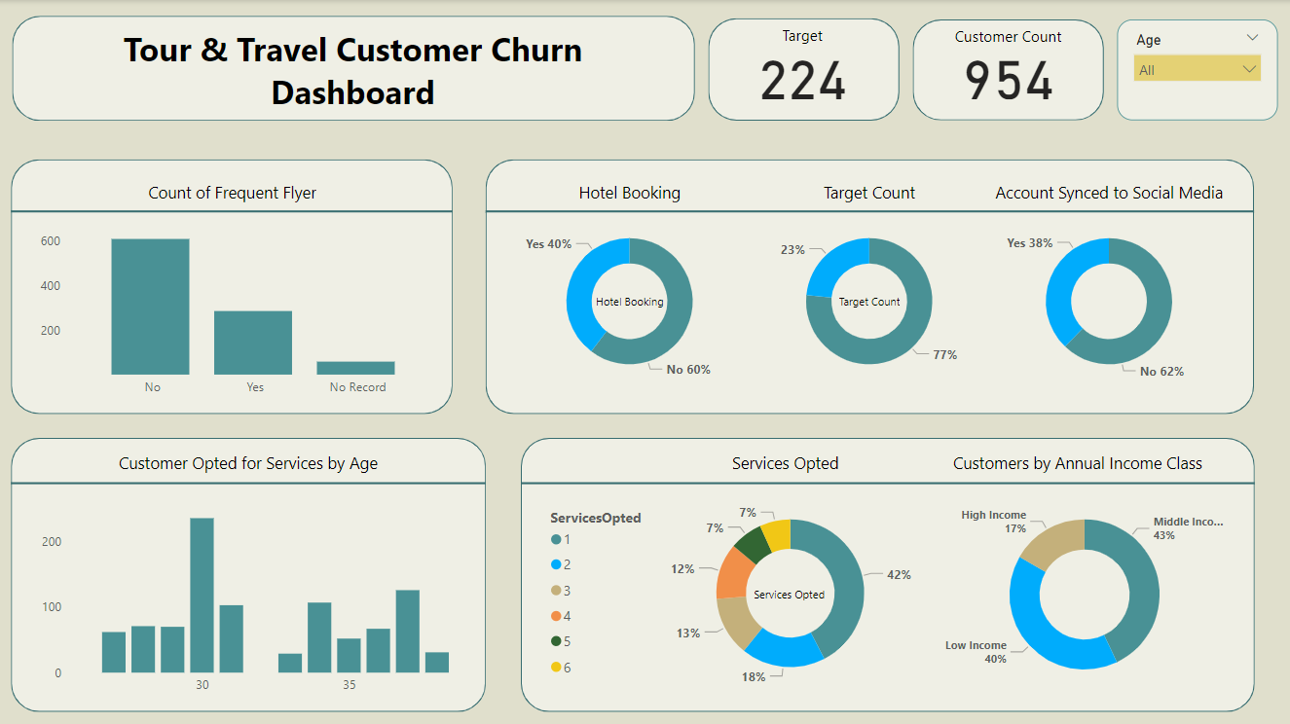
Dashboard

Slide 9
SUMMARY OF FINDINGS
& RECOMMENDATIONS
Key findings include the strong influence of age and income on service preferences, the critical role of social media engagement, and identified patterns in hotel booking choices.
Based on the analysis, we recommend enhancing personalized marketing for different age and income segments, leveraging social media for engagement, and focusing on services with higher retention rates.

Slide 10
CONCLUSION
This study underscores the importance of tailored strategies in reducing customer churn and highlights actionable insights for improving customer retention in the tour and travel industry.

Slide 11
THANK YOU

